Slide 1
Computer Organization Principles
School of Software, Dalian University of Technology
Chi Lin (林驰)
chilin@mail.dlut.edu.cn

Slide 2
Chapter 3 Representing & Manipulating Information
Contents
Data Representation & Encoding
Integer Representations
Integer Arithmetic
Floating Point
Arithmetic Logical Unit (ALU)

Slide 3
Integer Representations
Integer Data Types
Unsigned Encodings
Two’s-Complement Encodings
Conventions between Signed and Unsigned
Expending & Truncating Numbers

Slide 4
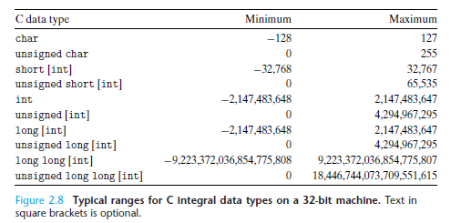
Integer Data Type (32-bit)

Slide 5
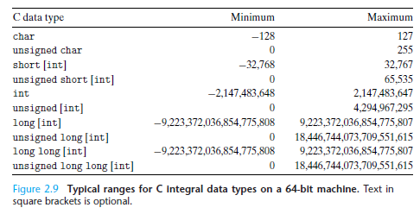
Integer Data Type (64-bit)

Slide 6
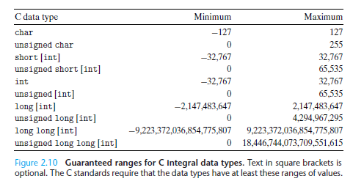
Guaranteed ranges for C integral data types

Slide 7
Unsigned Encodings
The most significant application of the Unsigned numbers in computer is ?????
In computing, unsigned number representations are required to encode 0 & positive numbers in binary number systems.
8 bit 0 ~ 255
16 bit 0 ~ 65535
unsigned int

Slide 8
Questions
In a 32-bit computer system, what is the range of the memory address ??
How about a 64-bit computer system ?
Given a n-bit unsigned number, can you figure out the max and min number in binary representation ?
Try to think out an equation that transform from a unsigned number into a decimal number.

Slide 9
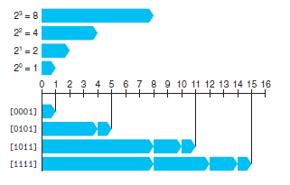
Examples of Unsigned Encoding
[0001]₂=1
[0101] ₂=4+1=5
[1011] ₂=8+2+1=11
[1111] ₂=8+4+2+1=15

Slide 10
Ranges & Mapping Relationship
Range: [0000] ₂~[1111] ₂ ([0,15])
UMin ₄ =[0000] ₂
UMax ₄ =[1111] ₂
Mapping Relationship: B2U_{w} ：{0,1}^{w}->{0,1,…,2^{w}-1}

Slide 11
Signed Number
In mathematics, negative numbers in any base are represented by prefixing them with a minus ("−") sign. However, in computer hardware, numbers are represented only as sequences of bits, without extra symbols.
The most common computer representation of signed numbers is known as two’s-complement form(补码).

Slide 12
Two’s-complement Encodings
The most common computer representation of signed numbers is known as two’s-complement form. This is defined by interpreting the most significant bit of the word to have negative weight.
[1111] ₂=-1
[0111] ₂=7

Slide 13
Questions
Given a n-bit unsigned number, can you figure out the max and min number in binary representation ?
Try to think out an equation that transform from a unsigned number into a decimal number.

Slide 14
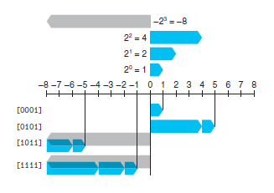
Two’s-Complement Example
Sign
Bit
[0001]₂=1
[0101] ₂=5
[1011] ₂=-5
[1111] ₂=-1

Slide 15
Ranges & Mapping Relationship
Range: [0000] ₂~[1111] ₂ ([-8,7])
TMin ₄ =[1000] ₂=-8
TMax ₄ =[1111] ₂=7
Mapping Relationship:
B2T_{w} ：{0,1}^{w}->{-2^{w-1},…,0,…,2^{w-1}-1}

Slide 16
Encoding Integers
Unsigned
Two’s Complement
short int x = 15213;
short int y = -15213;
Sign
Bit
C short 2 bytes long
Sign Bit
For 2’s complement, most significant bit indicates sign
0 for nonnegative
1 for negative

Slide 17
Encoding Example (Cont.)
x = 15213: 00111011 01101101
y = -15213: 11000100 10010011

Slide 18
Numeric Ranges
Two’s Complement Values
TMin = –2^{w–1}
100…0
TMax = 2^{w–1} – 1
011…1
Other Values
Minus 1
111…1
Unsigned Values
UMin = 0
000…0
UMax = 2^{w} – 1
111…1
Values for W = 16

Slide 19
Values for Different Word Sizes
Observations
|TMin | = TMax + 1
Asymmetric range
UMax = 2 * TMax + 1
C Programming
#include <limits.h>
Declares constants, e.g.,
ULONG_MAX
LONG_MAX
LONG_MIN
Values platform specific

Slide 20
Unsigned & Signed Numeric Values
Equivalence
Same encodings for nonnegative values
Uniqueness
Every bit pattern represents unique integer value
Each representable integer has unique bit encoding
⇒ Can Invert Mappings
U2B(x) = B2U⁻¹(x)
Bit pattern for unsigned integer
T2B(x) = B2T⁻¹(x)
Bit pattern for two’s comp integer
X
B2U(X)
B2T(X)
0000
0
0
0001
1
1
0010
2
2
0011
3
3
0100
4
4
0101
5
5
0110
6
6
0111
7
7
1000
8
–8
1001
9
–7
1010
10
–6
1011
11
–5
1100
12
–4
1101
13
–3
1110
14
–2
1111
15
–1

Slide 21
Programming Problem
A Casting Problem: Given a w-bit signed number
What is the usage of Casting?
Why casting is feasible? One-to-one correspondence, bijection.
When to cast? Explicitly vs Implicitly
How to cast???

Slide 22
Mapping Between Signed & Unsigned
Two’s Complement
Unsigned
T2U
x
T2B
B2U
ux
X
Maintain Same Bit Pattern
Unsigned
U2T
Two’s Complement
ux
U2B
B2T
x
X
Maintain Same Bit Pattern
Mappings between unsigned and two’s complement numbers: keep bit representations and reinterpret

Slide 23
Mapping Signed ↔ Unsigned
Bits
0000
0001
0010
0011
0100
0101
0110
0111
1000
1001
1010
1011
1100
1101
1110
1111
Signed
0
1
2
3
4
5
6
7
-8
-7
-6
-5
-4
-3
-2
-1
Unsigned
0
1
2
3
4
5
6
7
8
9
10
11
12
13
14
15
T2U
U2T

Slide 24
Mapping Signed ↔ Unsigned
Bits
0000
0001
0010
0011
0100
0101
0110
0111
1000
1001
1010
1011
1100
1101
1110
1111
Signed
0
1
2
3
4
5
6
7
-8
-7
-6
-5
-4
-3
-2
-1
Unsigned
0
1
2
3
4
5
6
7
8
9
10
11
12
13
14
15
=
+/- 16

Slide 25
Relation between Signed & Unsigned
Two’s Complement
Unsigned
T2U
x
T2B
B2U
ux
X
Maintain Same Bit Pattern
w–1
0
ux
+
+
+
• • •
+
+
+
x
-
+
+
• • •
+
+
+
Large negative weight
becomes
Large positive weight

Slide 26
Conversion Visualized
2’s Comp. → Unsigned
Ordering Inversion
Negative → Big Positive
UMax
UMax – 1
TMax + 1
Unsigned
Range
TMax
TMax
2’s Complement Range
0
0
–1
–2
TMin

Slide 27
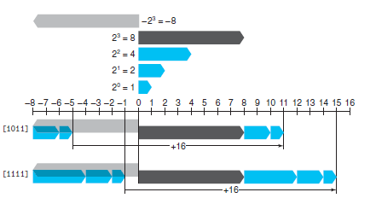
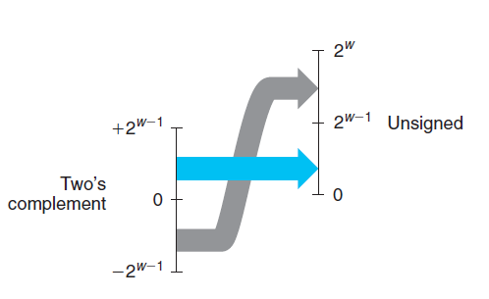
Examples (From T to U)
Mappings between unsigned and two’s complement numbers: keep bit representations and reinterpret

Slide 28
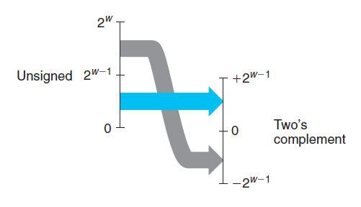
Examples (From U to T)
Mappings between unsigned and two’s complement numbers: keep bit representations and reinterpret

Slide 29
Signed vs. Unsigned in C Language
Constants
By default are considered to be signed integers
Unsigned if have “U” as suffix
0U, 4294967259U
Casting
Explicit casting between signed & unsigned same as U2T and T2U
int tx, ty;
unsigned ux, uy;
tx = (int) ux;
uy = (unsigned) ty;
Implicit casting also occurs via assignments and procedure calls
tx = ux;
uy = ty;

Slide 30
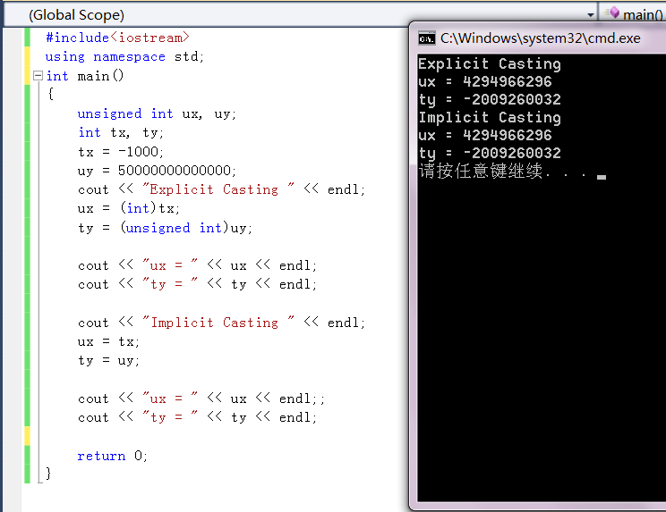
Explicit & Implicit Casting

Slide 31
Casting Surprises
Expression Evaluation
If there is a mix of unsigned and signed in single expression, signed values implicitly cast to unsigned
Including comparison operations <, >, ==, <=, >=
Examples for W = 32: TMIN = -2,147,483,648 , TMAX = 2,147,483,647

Slide 32
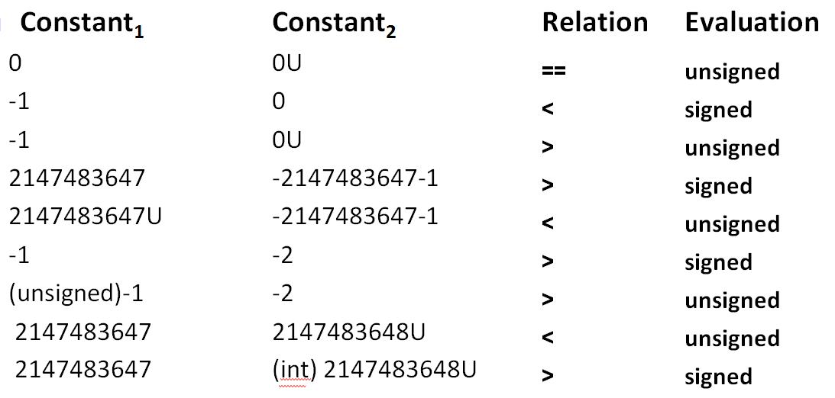
Casting Cases
Notes:
存在unsigned 的抓换为unsigned 只有都为signed时，才按signed判定

Slide 33
Code Security Example
/* Kernel memory region holding user-accessible data */
#define KSIZE 1024
char kbuf[KSIZE];
/* Copy at most maxlen bytes from kernel region to user buffer */
int copy_from_kernel(void *user_dest, int maxlen) {
/* Byte count len is minimum of buffer size and maxlen */
int len = KSIZE < maxlen ? KSIZE : maxlen;
memcpy(user_dest, kbuf, len);
return len;
}
Similar to code found in FreeBSD’s implementation of getpeername
There are legions of smart people trying to find vulnerabilities in programs

Slide 34
Typical Usage
/* Kernel memory region holding user-accessible data */
#define KSIZE 1024
char kbuf[KSIZE];
/* Copy at most maxlen bytes from kernel region to user buffer */
int copy_from_kernel(void *user_dest, int maxlen) {
/* Byte count len is minimum of buffer size and maxlen */
int len = KSIZE < maxlen ? KSIZE : maxlen;
memcpy(user_dest, kbuf, len);
return len;
}
#define MSIZE 528
void getstuff() {
char mybuf[MSIZE];
copy_from_kernel(mybuf, MSIZE);
printf(“%s\n”, mybuf);
}

Slide 35
Malicious Usage
/* Declaration of library function memcpy */
void *memcpy(void *dest, void *src, size_t n);
/* Kernel memory region holding user-accessible data */
#define KSIZE 1024
char kbuf[KSIZE];
/* Copy at most maxlen bytes from kernel region to user buffer */
int copy_from_kernel(void *user_dest, int maxlen) {
/* Byte count len is minimum of buffer size and maxlen */
int len = KSIZE < maxlen ? KSIZE : maxlen;
memcpy(user_dest, kbuf, len);
return len;
}
#define MSIZE 528
void getstuff() {
char mybuf[MSIZE];
copy_from_kernel(mybuf, -MSIZE);
. . .
}

Slide 36
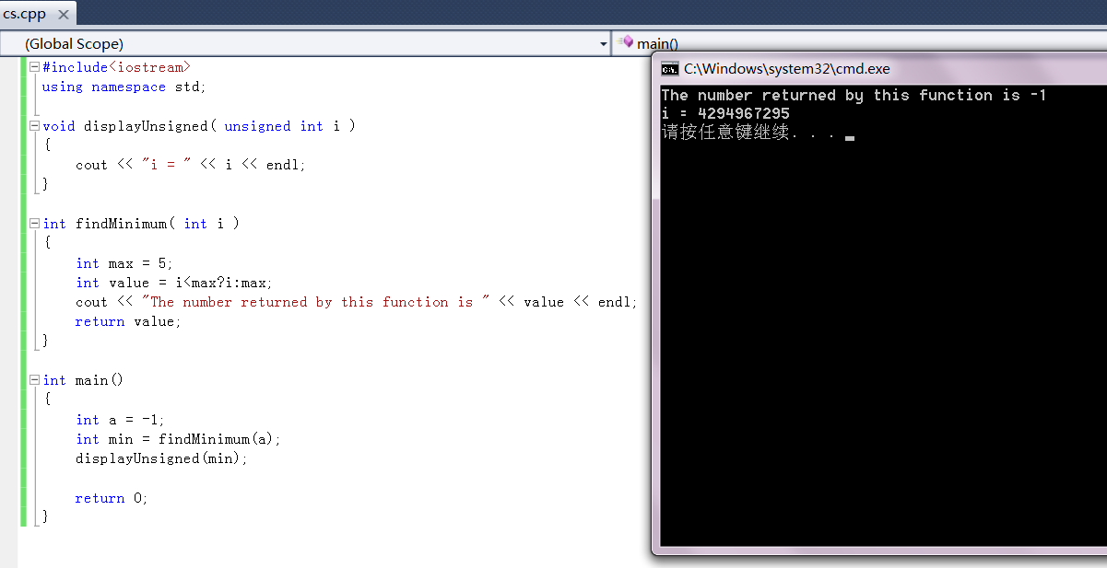

Slide 37
How to solve this problem ?
So, now you are capable of being a hacker, or a defender.
int copy_from_kernel(void *user_dest, int maxlen)
int copy_from_kernel(void *user_dest, size_t maxlen)

Slide 38
Homework
Revision:one’s comp(反码), true code(原码
)
Find a quick way to compute -x from x using the searching engine.
Practice Problem 2.17
Practice Problem 2.19
Practice Problem 2.23

Slide 39
Thank You

